Slide 1
Hibernate
Adith.naveen@gmail.com
Naveen Kumar K.S

Slide 2
What is Hibernate?
Hibernate is an object-relational mapping framework
Established in 2001
It provides tools to get Java objects in an out of the database
It does so without a lot of intrusion
You don’t have to know a lot of Hibernate API.
You don’t have to know a lot of SQL

Slide 3
Why use Hibernate?
Too much developer time is spent getting data in and out of the database and objects(in case of java objects)
Take a guess!
What percentage of development time is spent writing code to persist or manage access to relational data?

Slide 4
Estimates Range
That’s 30-70% of your developer time…
Not spent on design
Not spent on writing business logic
Not testing the application
Not solving business problem

Slide 5
More on why Hibernate…
Hibernate’s stated goal “is to relieve the developer from 95 percent of common data persistence related programming task”
Hibernate can also help your application be more platform independent/portable
Hibernate can help with performance!
Hibernate generates efficient queries consistently

Slide 6
Alternatives
Hibernate is certainly not the only object-relational mopping framework.
There are man commercial & open source option
Java Persistence API – still a very young and evolving API by Sun, still finding implementation issue
Java Data Objects(JDO) –
EJB Container managed Persistence (CMP) – guided by specifications.
iBatis – Flexible open source product but requires a log of SQL skills.
TopLink – commercial product now owned by Oracle
Castor- Open source ORM but not as popular or as fast as Hibernate

Slide 7
Inheritance
Inheritance and polymorphism are important concepts in OO programming language like java
Add power and flexibility to our programming environments
Databases have no equivalent concept to inheritance
Mapping inheritance trees in java to the database creates an opportunity for creativeness

Slide 8
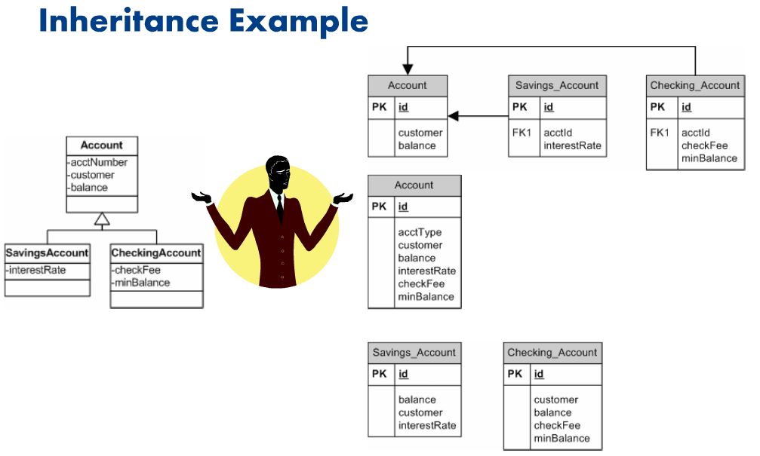

Slide 9
Datatypes
Even simple types are not easily mapped between java and the major relational databases
For that mater, simple data types are not easily mapped among the various vendor relational database

Slide 10
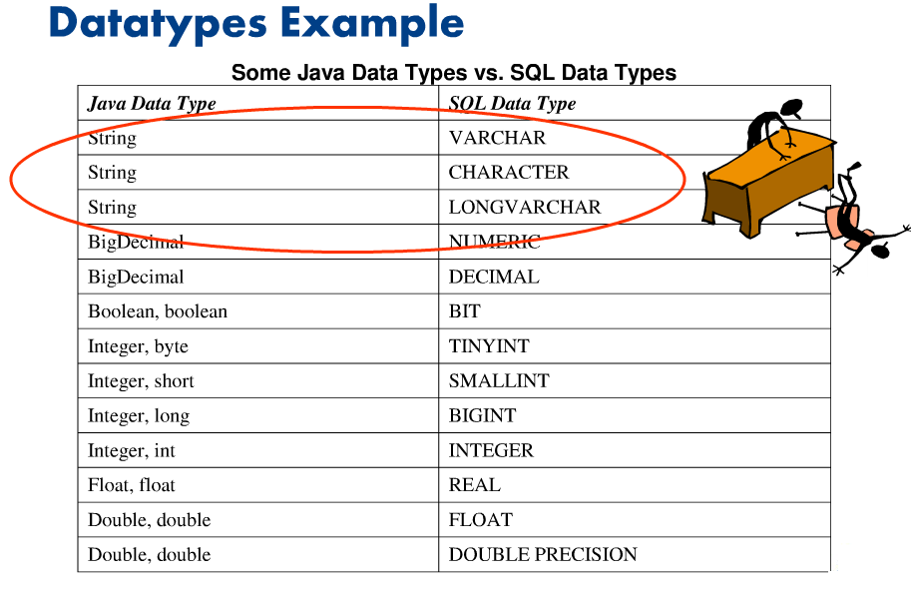

Slide 11
Hibernate to the Rescue
Hibernate handles all of these issues
In fact, hibernate provides several options in most cases to allow you to handle them in a variety of ways.

Slide 12
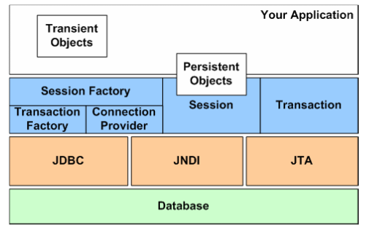
Hibernate Architecture and API
Again, the point of Hibernate is to be non- interfering with regard to your application.
Removing SQL and JDBC-like calls from business code as much as possible.
The hibernate architecture is actually quite simple

Slide 13
Configuration
As seen in the example code, a configuration object is the first Hibernate object you use.
The configuration object is usually created once during application initialization
The configuration object reads and establishes the properties Hibernate uses to get connected.
By default, the Configuration loads configuration property information and mapping files from the classpath.
The Configuration object can be told explicitly where to find files
The configuration object is used to create a SessionFactory

Slide 14
SessionFactory
The sessionFactory is created from a configuration object
SessionFactory sf = config.buildSessionFactory();
The SessionFactory is an expensive object to create
It too is usually created during application start up
It should be created once and dept for later use.
The sessionFactory object is used by all the thread of an application.
It is a thread safe object
One SessionFactory is created per database(where connecting to multiple databases).
The SessionFactory is used to created Session objects.

Slide 15
Session
The session object is created from the SessionFactory object.
Session sess = sf.openSession();
A Session object is lightweight and inexpensive to create.
Session objects provide the main interface to accomplish work with the database
Does the work of getting a physical connection to the database(hopefully from a connection pool).
Session objects are not thread safe.
Session objects should not be kept open for a long time
Applications create and destroy these as needed. Typically, they are created to complete a single unit of work.
When modifications are made to the database, session objects are used to create a transaction object.

Slide 16
Transaction
Transaction objects are obtained from the session object when a modification to the database is needed.
Session.beginTransaction();
The Transaction object provides abstraction for underlying implementation.
Hibernate with use whatever transaction implementation is available(JDBC, JTA etc).
It is optional; allowing developers to use their own transactional infracture.

Slide 17
API Basics
Configuration, SessionFactory, Session and Transaction(along with your own persistent classes)
In fact most of the Hibernate “Coding” is spent on
hibernate.cfg.xml
The toughest part of Hibernate is getting your persistent mapping file set up.

Slide 18
Object Lifecycle
Persistent object are synchronized with the database
Domain objects are in one of three states
Transient
Persistent
Detached
An object state determine if it is kept synchronized with database
The presence of a session and certain method calls move an object between states.

Slide 19
